Slide 1

GPU-Accelerated Number Theoretic Transform (NTT)
Architecture-aware CUDA kernels on the NVIDIA RTX 2080 Ti
Kareem Bwakny · Hakeem Najjar
Advisor: Mr. Oren Ganon Project No. 3363
Iby & Aladar Fleischman Faculty of Engineering — Tel Aviv University

Slide 2
Motivation & Goal
The NTT is the modular-arithmetic FFT — the inner loop of post-quantum (lattice) cryptography, homomorphic encryption, and zero-knowledge proofs, where millions of transforms are evaluated.
Single-NTT latency and throughput set whole-system performance, and the transform is massively parallel → the GPU is the natural target.
Goal: implement and optimize the NTT as architecture-aware CUDA kernels on an RTX 2080 Ti and beat the state-of-the-art GPU-NTT library on the same GPU.
Every kernel is correctness-gated bit-exactly before it is timed.

Slide 3
Background: the NTT and its GPU bottlenecks
Radix-2 Cooley–Tukey: log₂N butterfly stages; each butterfly = one modular multiply + a modular add/sub.
The modular multiply dominates the critical path (shortened by Barrett / Shoup reduction).
The binding bottleneck changes with the regime:
latency — small N
shared-memory bank conflicts — mid N
grid occupancy — large N, low batch
DRAM bandwidth — saturation
Key insight: no single kernel is optimal across all (N, batch).

Slide 4
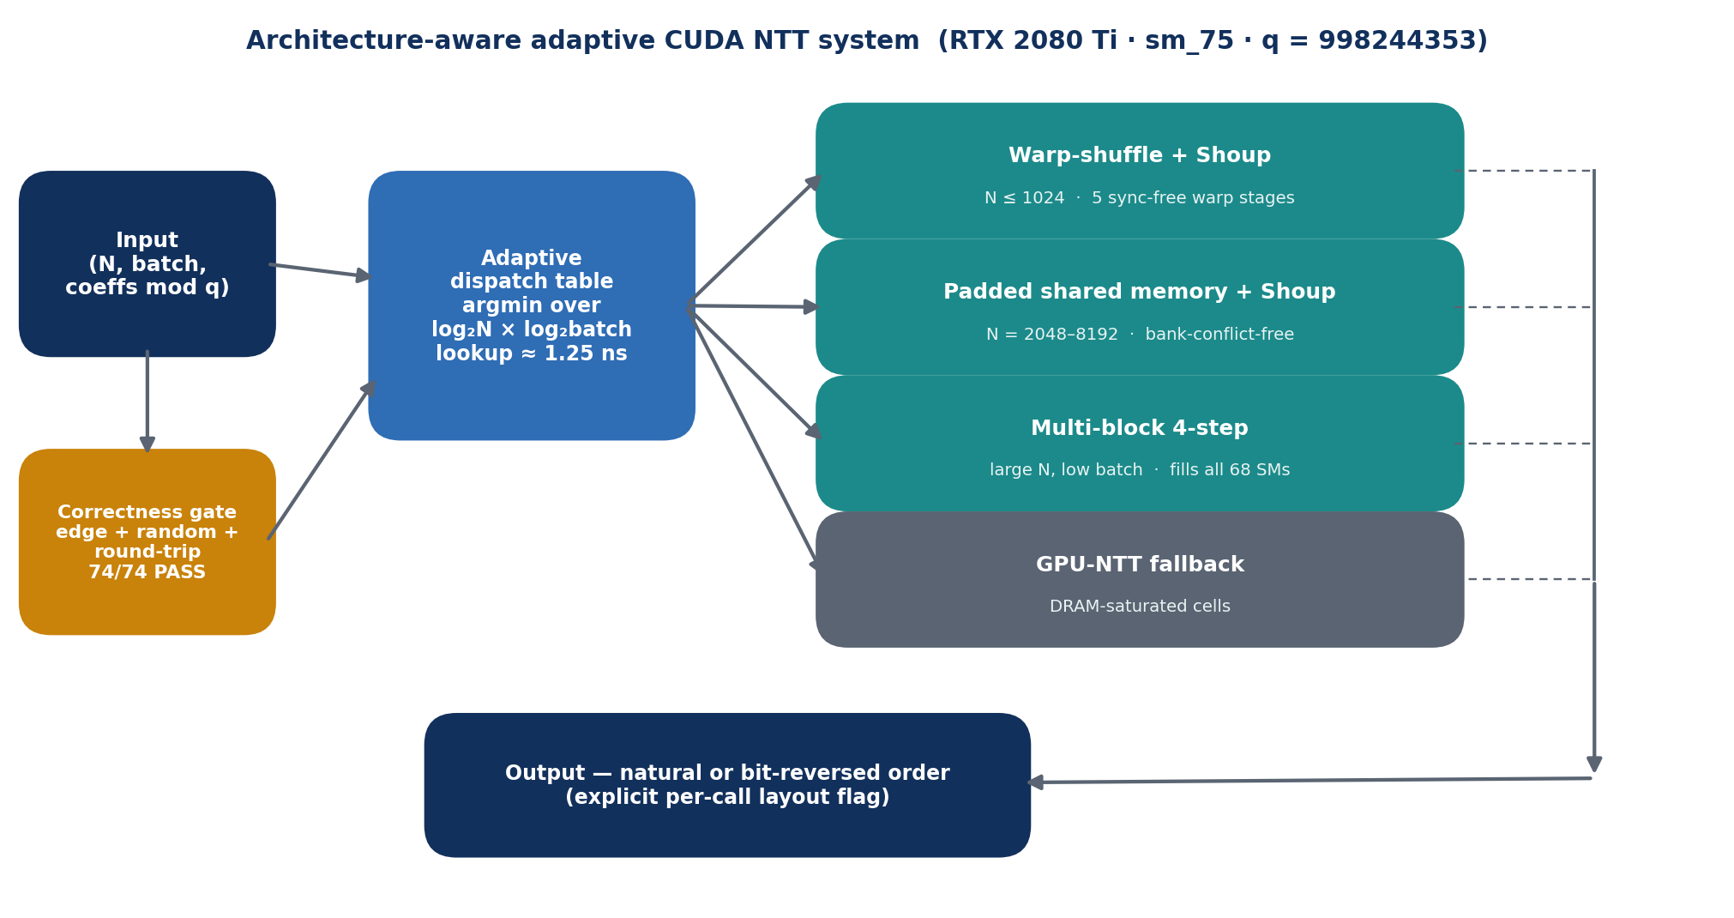
Approach: specialize per regime, dispatch by measurement
One specialized kernel per binding hardware constraint.
A compiled table routes the measured-best backend per (N, batch) — lookup ≈ 1.25 ns.
GPU-NTT is retained as a fallback, so the system is never worse than the reference library.

Slide 5
Four architecture-aware CUDA kernels
Warp-shuffle + Shoup (N ≤ 1024): first 5 butterfly stages run in registers via __shfl_xor — no shared memory, no barriers (4.5 µs latency floor).
Padded shared memory (N = 2048–8192): one pad word per 32 elements → bank-conflict-free (up to 1.32×).
Multi-block 4-step (large N, low batch): splits one transform across all 68 SMs (up to 3.60× vs single-block).
Shoup modular multiply shortens the butterfly dependency chain — 0 register spills, 100% theoretical occupancy.

Slide 6
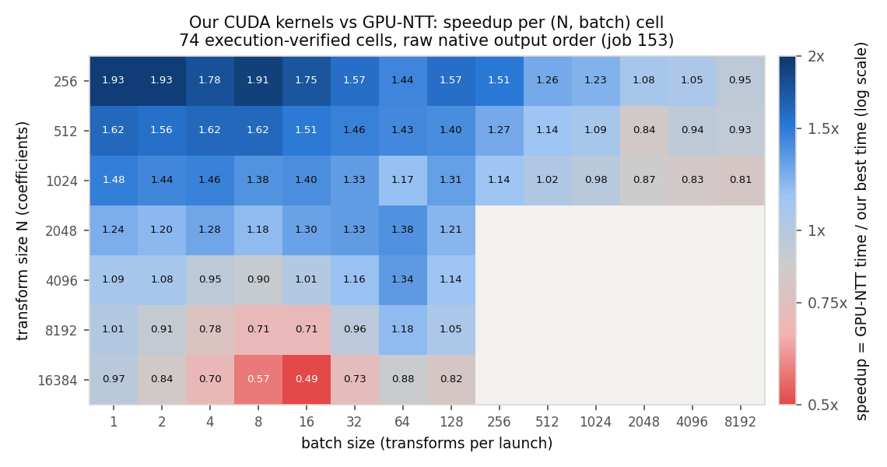
Results: head-to-head vs GPU-NTT
48 / 74 execution-verified cells won (tie in 4), up to 1.93×.
Strongest region: N ≤ 1024 at batches 1–2048 — the lattice-crypto sweet spot.
The selector is never worse than GPU-NTT (worst regret ≈ 5%).
GPU-NTT wins only the DRAM-saturated cells — routed back to it.

Slide 7
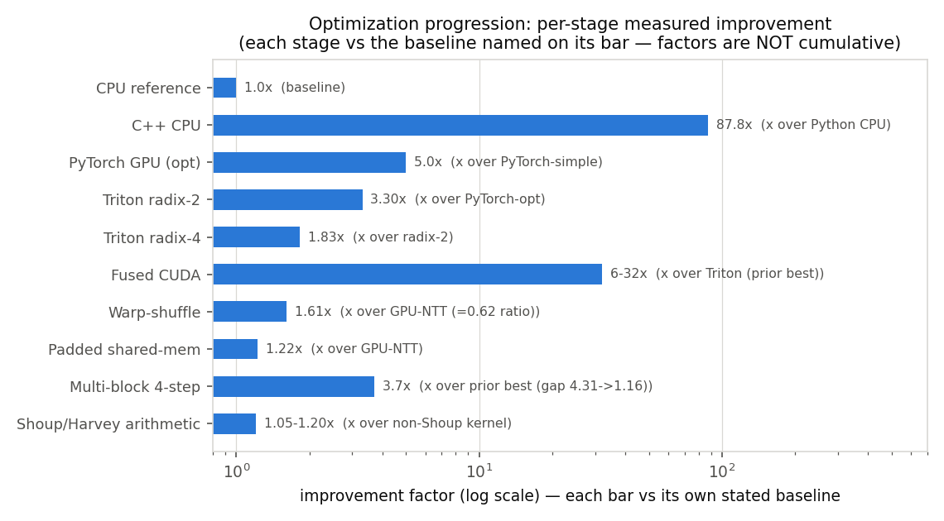
Substantial, measured speedups
Up to 58.6× over an optimized C++ CPU baseline.
The custom kernel reaches 82% of peak memory bandwidth.
Peak 110.9 M transforms/second (N=256, batch 8192).
Each optimization measured against its own baseline.

Slide 8
Conclusions
Architecture-aware mapping of the NTT onto the GPU produced large, measured speedups over both the CPU baseline and the previous GPU implementation.
The adaptive runtime turns specialized kernels into a deployable system that is never slower than the state-of-the-art GPU-NTT library.
Correctness was never traded for speed — the transform convention was formally verified and natural-order output is an explicit feature.

Slide 9
Future work
Persistent small-N megakernel to push past the kernel-launch floor.
sm_80+ cp.async double-buffered padded kernel; evaluate the integer tensor-core path.
Self-calibrating dispatch table that re-profiles automatically on a new GPU.
Full ML-KEM / Kyber pipeline — a preliminary case study already shows a 12.3× arithmetic-core improvement.
Thank you!

